Slide 1

CAN Signal Packing & Unpacking
CAN bus transmits data in bytes (8 bits) | Packing: putting signal values into CAN bytes for transmission.
Signals (like speed, gear) may be smaller than a byte or combined in one byte | Unpacking: extracting signal values from received CAN bytes.
Packing (Sender Side)
Unpacking (Receiver Side)
  Performed on receiver side after CAN frame is received
  Extract original signal values from CAN data bytes
  Reverse operation of packing
  Uses:
    Bit shifting
    Bit masking
  Output signals are used for SOA services
  Applications / debugging / logging
Example :
uint16_t speed;
speed = can_data[0] | (can_data[1] << 8);
  Unpacking Steps
  Read CAN data bytes
  Shift bits to original position
  Mask required bits
  Combine bits to reconstruct signal
Convert signal to binary.
Mask unwanted bits using & (example: & 0xFF for 1 byte).
Shift bits to correct position using <<
Combine multiple signals in one byte using |
Store final value in CAN data array,
Example :
uint8_t can_data[8];
can_data[0] = speed & 0xFF; // lower byte
can_data[1] = (speed >> 8) & 0xFF; // upper byte
For two signals in one byte:
can_data[2] = ((speed & 0x0F) << 4) | (gear & 0x0F);
Key points:
  Mask = keep only relevant bits
  Shift = place bits in proper position
  Combine = | operator for multiple signals

Slide 2
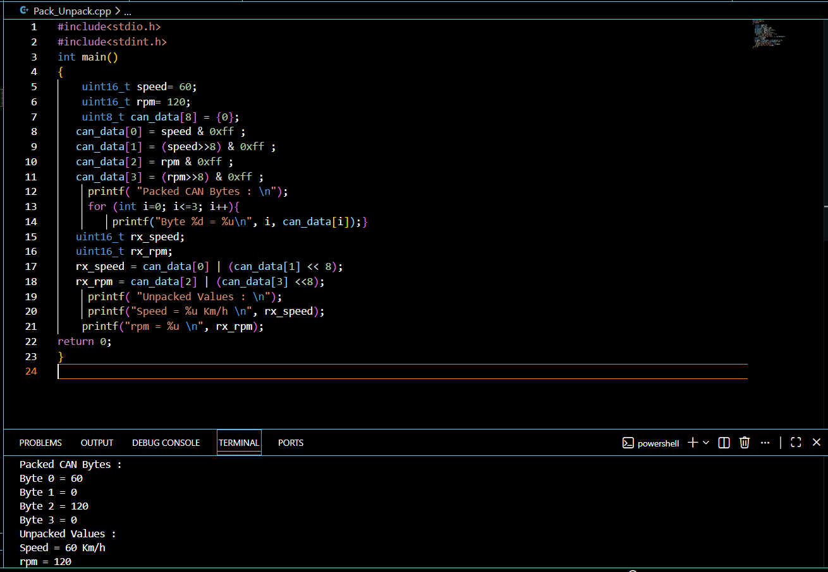
CAN Signal Packing & Unpacking
CAN bus transmits data in bytes (8 bits) | Packing: putting signal values into CAN bytes for transmission.
Signals (like speed, gear) may be smaller than a byte or combined in one byte | Unpacking: extracting signal values from received CAN bytes.
Packing (Sender Side)
Convert signal to binary.
Mask unwanted bits using & (example: & 0xFF for 1 byte).
Shift bits to correct position using <<
Combine multiple signals in one byte using |
Store final value in CAN data array,
Unpacking (Receiver Side)
  Performed on receiver side after CAN frame is received
  Extract original signal values from CAN data bytes
  Reverse operation of packing
  Uses:
    Bit shifting
    Bit masking
  Output signals are used for SOA services
  Applications / debugging / logging
  Unpacking Steps
  Read CAN data bytes
  Shift bits to original position
  Mask required bits
  Combine bits to reconstruct signal
  Practice Example :

